Slide 1
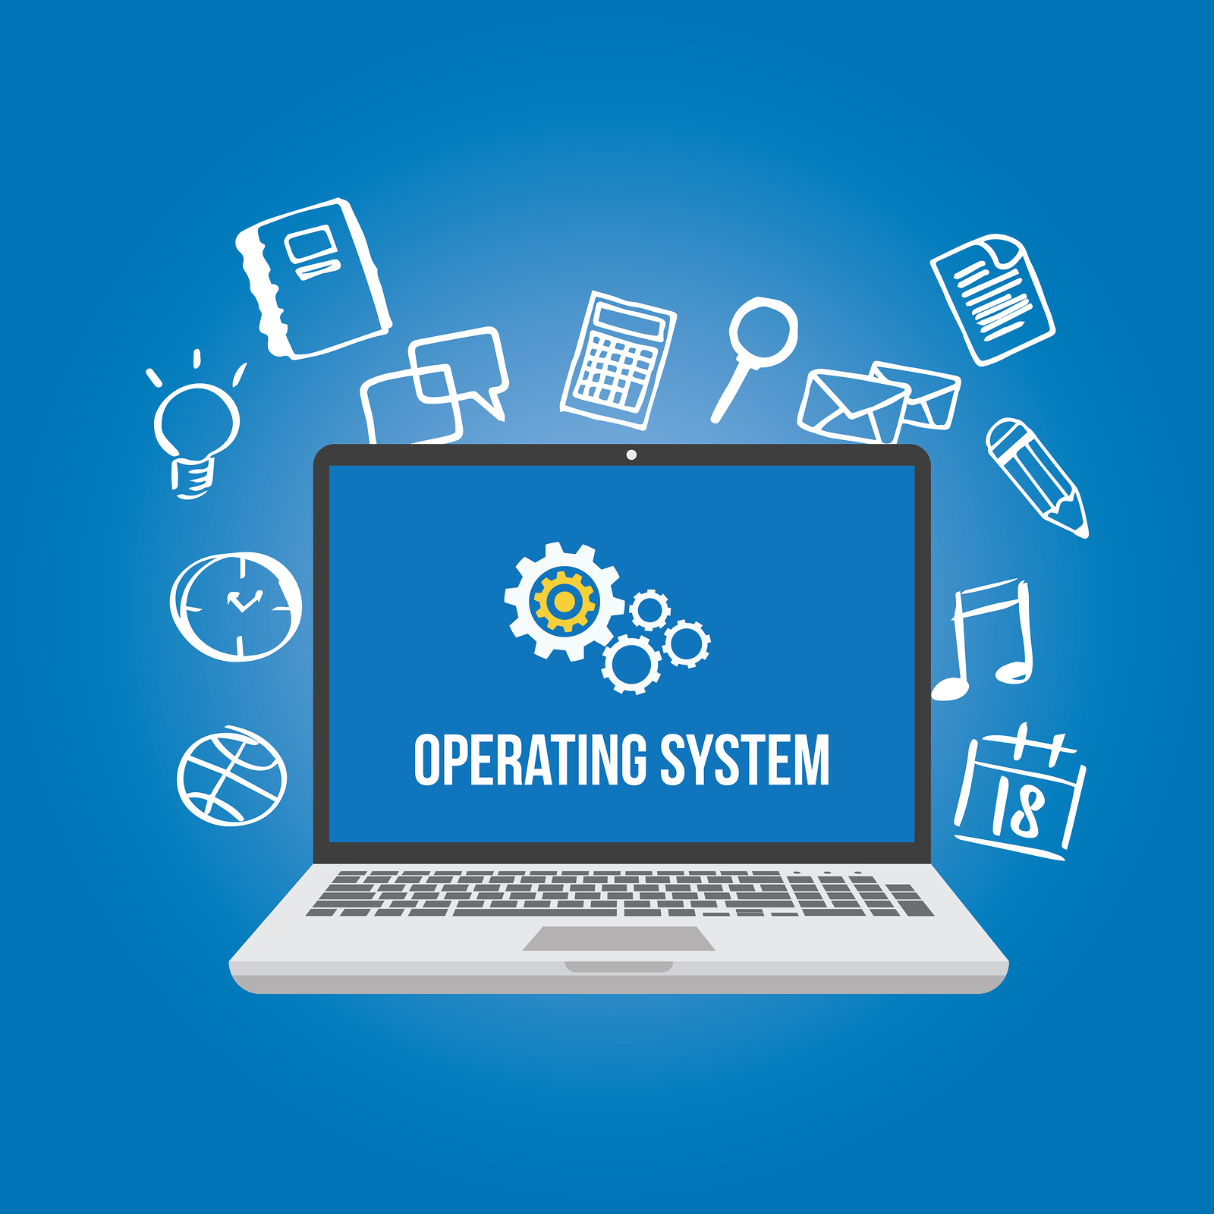
CPU SCHEDULING
GYANVI ASHISH CHAUDHARY(2100290110057)
ABHINAV SHARMA(2100290110004)

Slide 2
CONTENTS
Introduction
Types of scheduling and their implementation
1. FCFS scheduling
2. SJF scheduling
3. Priority scheduling
4. Round Robin Scheduling

Slide 3
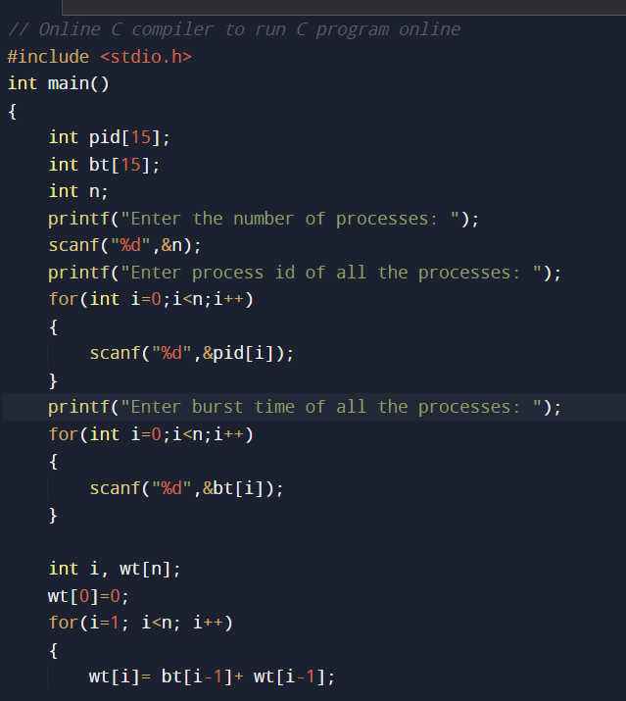
1. FCFS scheduling
The CPU scheduling algorithm First Come, First Served (FCFS), also known as First In, First Out (FIFO), allocates the CPU to the processes in the order they are queued in the ready queue
FCFS uses non-preemptive scheduling, which means that once a CPU has been assigned to a process, it stays assigned to that process until it is either not terminated or may be interrupted by an I/O interrupt.

Slide 4
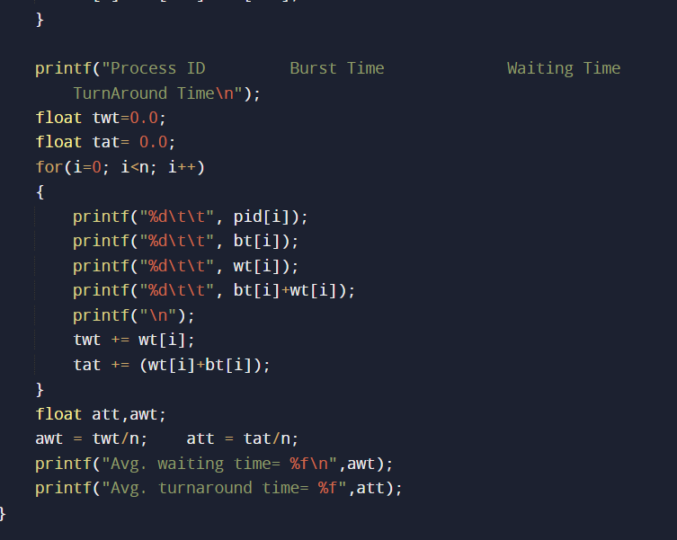
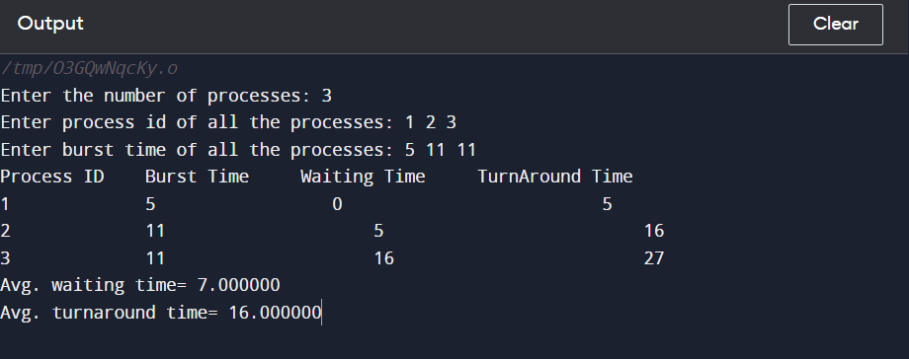
1. FCFS scheduling
OUTPUT:

Slide 5
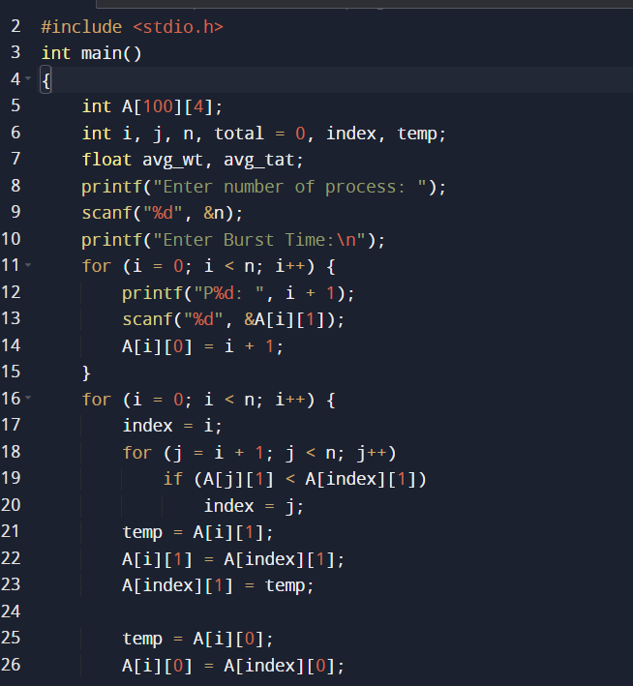
2.SJF Scheduling
The shortest job first (SJF) or shortest job next, is a scheduling policy that selects the waiting process with the smallest execution time to execute next. SJN, also known as Shortest Job Next (SJN), can be preemptive or non preemptive.

Slide 6
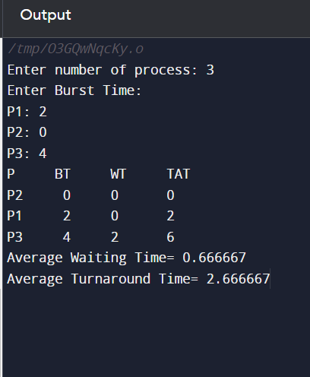
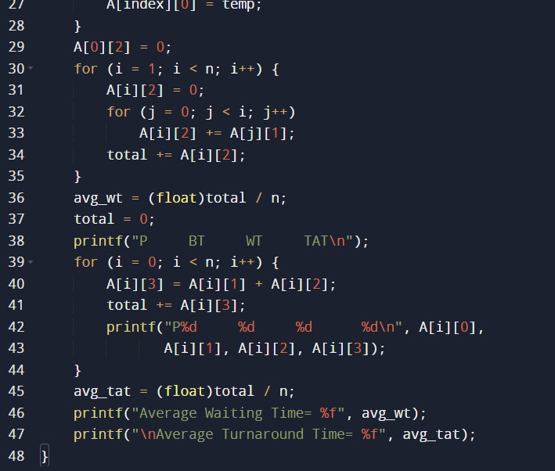
2.SJF Scheduling
OUTPUT

Slide 7
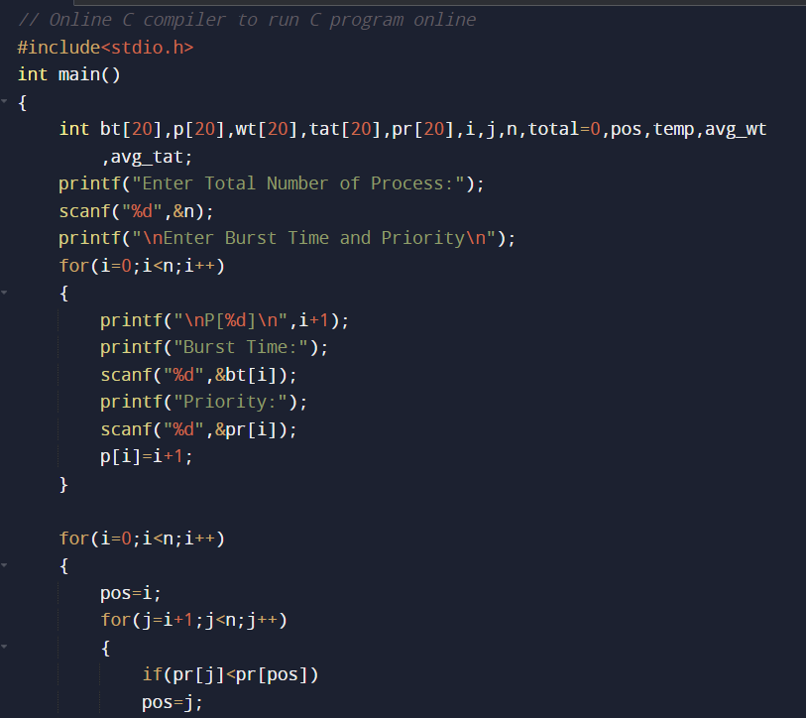
3. Priority Scheduling
In Priority scheduling, there is a priority number assigned to each process. In some systems, the lower the number, the higher the priority. While, in the others, the higher the number, the higher will be the priority. The Process with the higher priority among the available processes is given the CPU. There are two types of priority scheduling algorithm exists. One is Preemptive priority scheduling while the other is Non Preemptive Priority scheduling

Slide 8
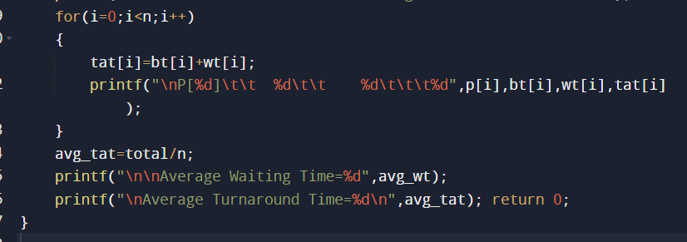
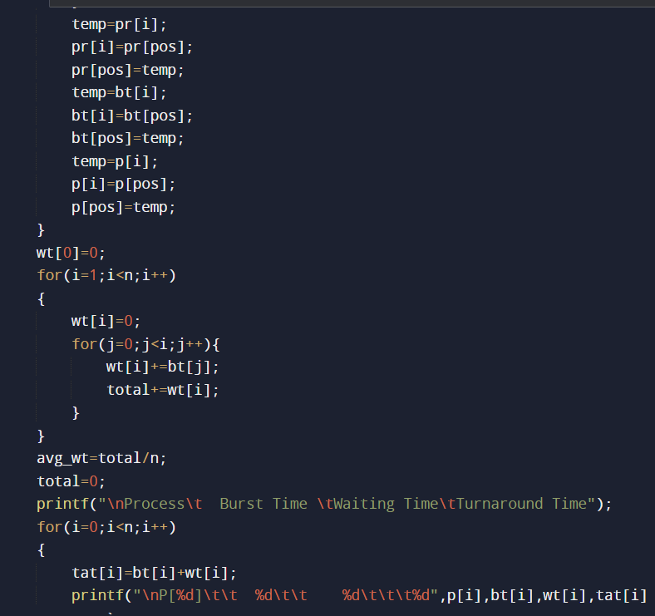
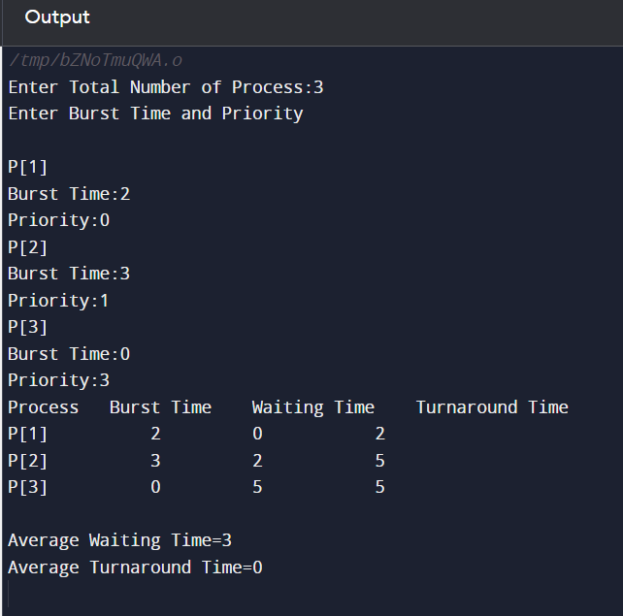
3. Priority Scheduling
OUTPUT

Slide 9
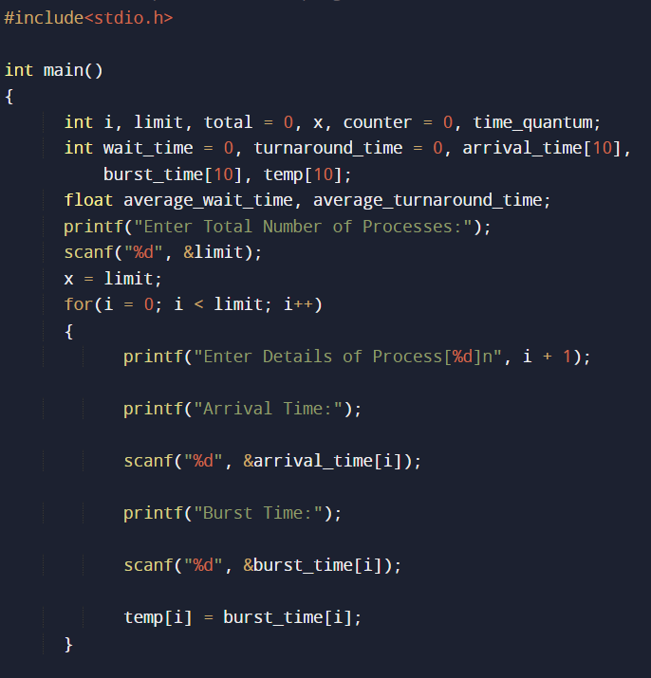
4. Round Robin Scheduling
The Round-robin scheduling algorithm is a kind of preemptive First come, First Serve CPU Scheduling algorithm where each process in the ready state gets the CPU for a fixed time in a cyclic way (turn by turn). It is the oldest scheduling algorithm, which is mainly used for multitasking.

Slide 10
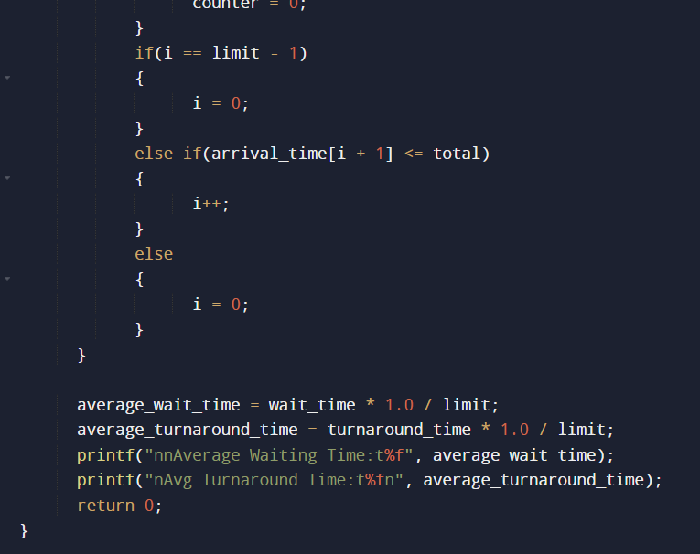
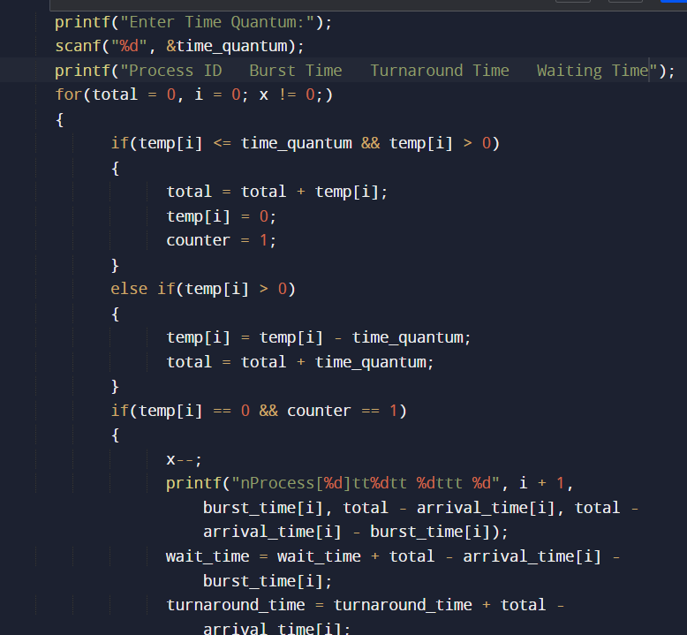
4. Round Robin Scheduling

Slide 11
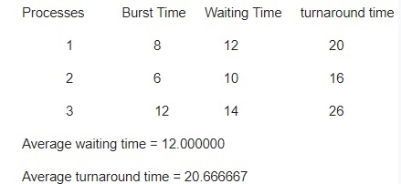
4. Round Robin Scheduling
OUTPUT

Slide 12
THANK YOU

